Slide 1
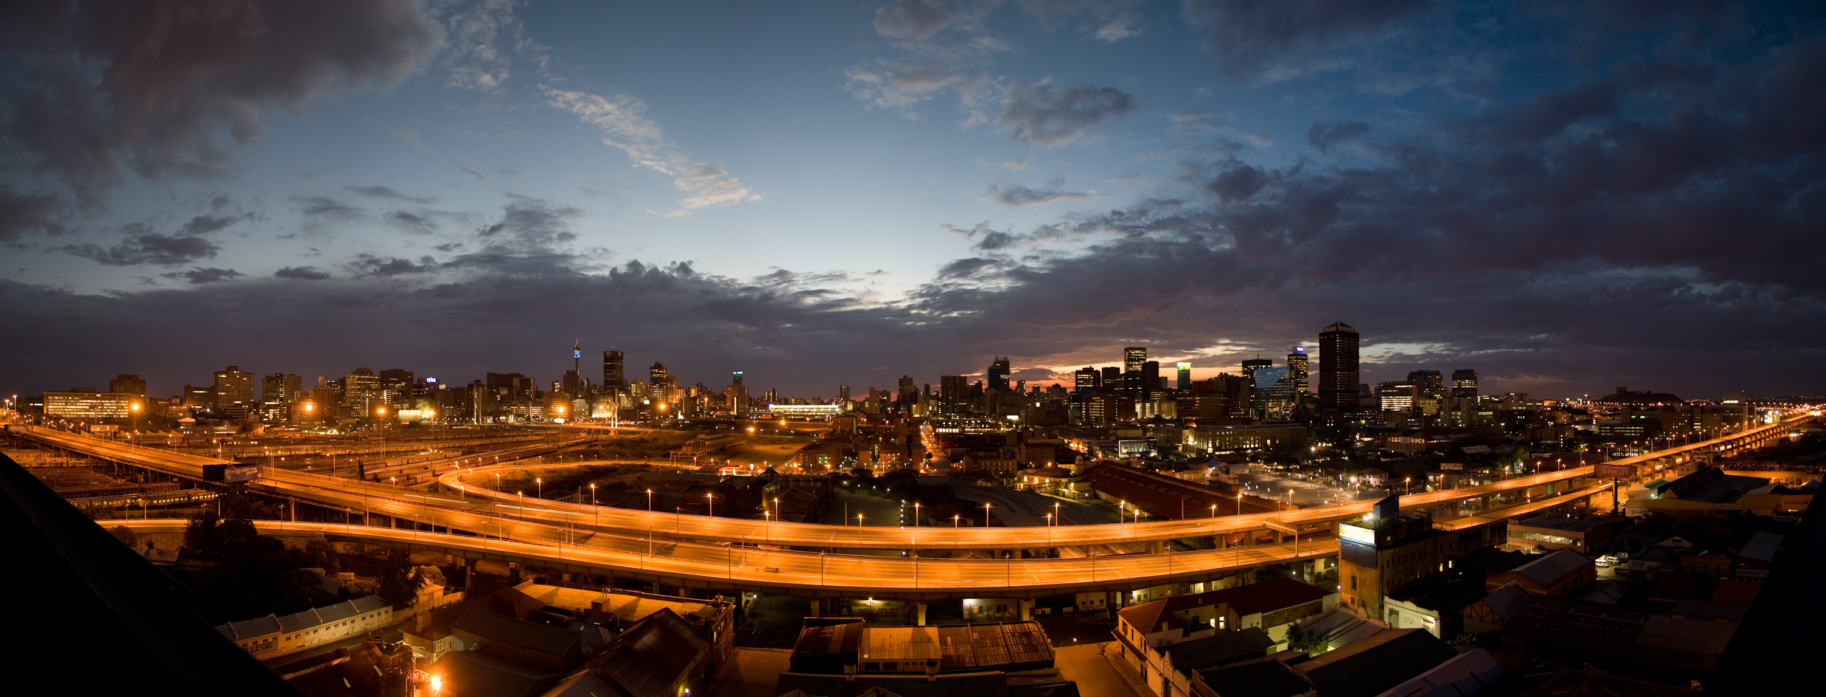
2019 Future of the City Centre Symposium
10 – 11 September
South Africa
Hosted by the UNISA Graduate School of Business Leadership

Slide 2
2019 Future of the City Centre Symposium
Women Access to the City- the case of Tshwane
Catherine Ndinda, Mudzunga Neluheni, Konosoang Sobane

Slide 3
How government interventions have facilitated access to the city for the women
Urban history of South Africa
Colonialism -indigenous Africans excluded from cities at local government level
Spatial segregation in cities started long before apartheid

Slide 4
Background Context
Rise of the Afrikaaner Nationalist Party (NP) to power gave all previous attempts to marginalise Africans a name - apartheid
Apartheid- Segregation, exclusion & dispossession
Apartheid -economic, political, and social dominance entrenched White supremacy
Institutionalized the oppression, marginalization & exclusion of non-whites from 1948 to 1994
Exclusion of Africans & specifically women was official policy

Slide 5
Background Context
Access to city – moderate conceptualization of the right to city
Right to adequate housing-critical in access to the city
Basis upon which other rights that also impinge on access to the city are fulfilled e.g. right to work, livelihood, freedom of movement and association
Right of participation & prioritisation of the needs of vulnerable & historically marginalised” (Rolnik, 2014:294)
Shapes the sense identity and belonging to a place
Access to city – gender-blind, gender-neutral perspective

Slide 6
Background Context
Neo-liberal conceptualizations of access to city –
Governance rescaled - policy re-oriented towards competition, not redistribution
Urban governance- no longer function of city authorities
Non-state actors - governance rather than government
Rights to individual property & the power owners wield in decisions taken by city authorities
Radical - oppressed, deprived, alienated

Slide 7
Post-apartheid Period – Access to city
Subsidised housing in both urban & rural areas
Adequate housing for poor & vulnerable members of society
Granting access to the city & the opportunities that cities offer
Adequate housing- access to infrastructural services (water, sanitation, transport)
Opportunities in city- transport routes, social services e.g. schools, shopping areas & local government departments

Slide 8
Interventions granting women access to city
Integrated residential development programme (IRDP)
People’s housing programme (PHP)
Social housing
Finance linked subsidy programme (FLISP)
Upgrading of informal settlements programme
Presentation text

Slide 9
Integrated residential development programme (IRDP)
Prioritises vulnerable households including female-headed households
Provide adequate housing – 40 m² with water, sanitation & electricity
Access roads & street lighting
Close to social amenities & economic opportunities

Slide 10
Subsidised housing projects in Tshwane
Hammanskraal West Ext 2 (Mega - Tshwane North Development)
Atteridgeville Backyard Rental (Accruals)
Thembelihle Village (social Housing)
(Thorntree View) Soshanguve South Ext 7
Soshanguve Block X Ext 1
Winterveldt 3 Phase 2 (Mega - Tshwane North Development)
Olievenhoutbosch Ext 27
Nellmapius Ext 22
Hailstorm Mamelodi (Rectification of 1662 X3 Houses)

Slide 11
Interventions granting women access to city
Women & subsidy beneficiaries satisfied with dwellings
Access to social and economic amenities a challenge – schools, clinics, government offices, post office, libraries, recreation parks etc.
Services found outside their communities
Access to city through local transportation routes – fatalities are high due to location of settlements
Dwellings for disabled provided – design of settlement excludes them
Lack of access routes into settlements constrain access to city for disabled including women
High levels of crime constrain access to city
High levels of unemployment
Presentation text

Slide 12
Interventions granting women access to city of Tshwane
Transportation routes to city
Location of housing within the city – Lady Selbourne & Danville
Exit roads away from highways (in some instances)
Different forms of transport – buses & taxis

Slide 13
Upgrading of informal settlements programme- (UISP)
Objective – health and safety
Community empowerment
Baseline evaluation of informal settlements targeted for upgrading (national survey)
Sample = 78 settlements and 3 330
City of Tshwane included
Presentation text

Slide 14
Upgrading of informal settlements programme- (UISP)
Informality – women’s agency in accessing the city
Land invasions
Illegal connection of power to access benefits of city living
Service delivery protests – access water, sanitation & housing
Illegal occupation of land compels local authority to regularize land tenure
Invasion of municipal land - permission to occupy

Slide 15
Upgrading of informal settlements programme- (UISP)
Plot 45 Pienaarspoort
Rethabiseng
Soshanguve KK 2
Stinkwater X4

Slide 16
Upgrading of informal settlements programme- (UISP) – Access to city
Access to city – close proximity to city
Connected to transport routes
Transport routes into the city – employment opportunities
Forms of transport – buses & taxis
Availability of trading spaces in city

Slide 17
FUTURE FOR WOMENS ACCESS TO THE CITY
Recommendations to consider for better governance of everyday lived spaces, infrastructure, transport and housing in regards to women’s access to the city:
1. Everyday lived spaces
Urban planning should be considerate of the politics of space & heterogeneity of places (Beebeejaun, 2017)
2. Infrastructure
Mainstreaming a gender perspective throughout the governance cycle and financing, including strategic planning, consultation process, project implementation coordination across levels of government, adequate use of data (OECD, 2019)

Slide 18
FUTURE FOR WOMEN’S ACCESS TO THE CITY
3. Transport (Inclusive Transit-Oriented Development)
Incorporate women, women’s human rights, and gender considerations into planning processes and policy framework.
Design streets that are safe for all users, with good working environments , intermediate modes, and public transport.
Develop communities by ensuring land-use and transport are well integrated, and deliver a mix of activities and services at the neighbourhood level.
Provide inclusive transport services and vehicle that meet varied trip patterns and needs beyond the commute.
Enable progress with funding, education and outreach to achieve inclusive sustainable mobility. (WEDO, 2018)

Slide 19
FUTURE FOR WOMEN’S ACCESS TO THE CITY
4. Housing (An approach to city plans for social housing)
Make mixed-income housing more politically viable and limit nimbyism through design. (Brophy and Smith, 1997)
For true integration to occur in mixed-income housing, marginalized groups would have to be involved in the process of relocation and infrastructure in place for participation (Duke, 2009)
Avoid undesired or unplanned displacement of residents from affordable units- establish strict evictions controls, including barring evictions unless alternative suitable accommodation can be found (Marcuse, 2016)

Slide 20
FUTURE FOR WOMEN’S ACCESS TO THE CITY
Increases in rents should be limited through reglations considering equity to tenants as well as to landlords (Marcuse, 2016)
Provide for some middle-income housing for potential gentrifiers in working-class neighbourhoods, but in numbers and under conditions acceptable to existing to residents through rent regulations and by prompting limited-equity and income-controlled occupancy

Slide 21
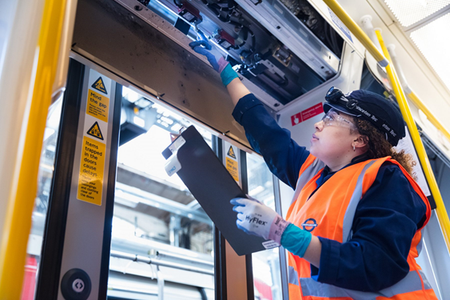
CASE STUDY
Gender mainstreaming policies in London
For accessibility, safety and security, affordability information and employment for women, Transport for London introduced gender-mainstreaming policies such as “Action on Equality” (2016-2020) to address employment in the transport sector
Initiatives such as the “Single Equality Scheme” (2012-2015) included accessible bus stops, clearer maps, real-time information on buses, and equal employment opportunities
Apprenticeships with Transport for London- https://www.iwantobea.com/apprenticeship/transport-for-london-apprenticeship/

Slide 22
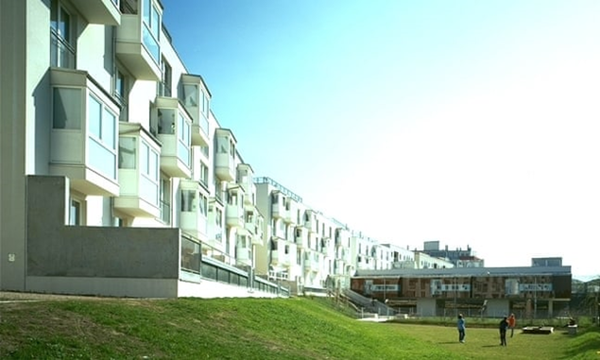
CASE STUDY
2. Mixed Uses and Activities in Vienna
Vienna instituted gender-mainstreaming policies into its urban planning, and since 1993 over 60 urban projects have been completed and designed with women in mind.
It now has improved street lighting, parks more accessible for girls, widened pavements, and new social housing and neighbourhood structures to fit the needs for women
Accommodation, the kindergarten and the one of the play areas of Frauen-Werk-Stadt Photograph: Margarita Spiluttini. https://www.theguardian.com/cities/2019/may/14/city-with-a-female-face-how-modern-vienna-was-shaped-by-women

Slide 23
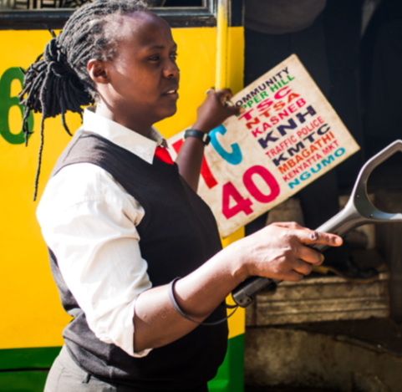
CASE STUDY
3. Gender Sensitization Training in Kenya
As a response to increased cases pf sexual harassment in public transport , Flone (an NPO focusing on ending violence against women and girls in public spaces) created “Usalama wa Uma”, a public safety certificate programme that provides gender sensitisation trainings, as well as personal and professional development workshops for public transport providers and operators.
A woman working in the transport industry in Nairobi, https://floneinitiative.org/

Slide 24
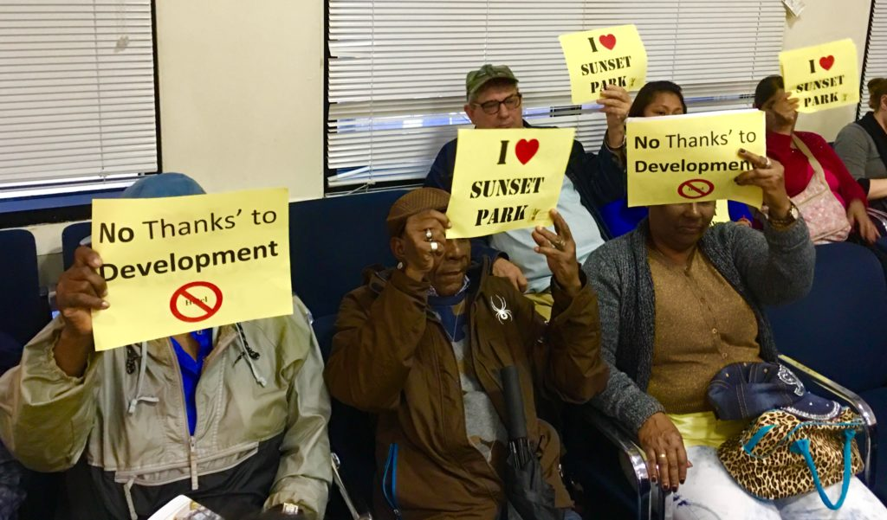
CASE STUDY
4. Middle-income housing in working-class neighbourhoods in New York
In New York, defined community boards establish the development conditions through the Uniform Land Use Review Procedure (ULURP).
The conditions include rent regulation to prevent market driven increases in housing prices
ULURP hearings sometimes draw protesters. In this 2017 photo, Brooklynites give a thumbs-down to zoning changes proposed for Industry City in Sunset Park. Eagle file photo by Lore Croghan- https://brooklyneagle.com/articles/2019/03/08/ulurp-explainer/

