Slide 1
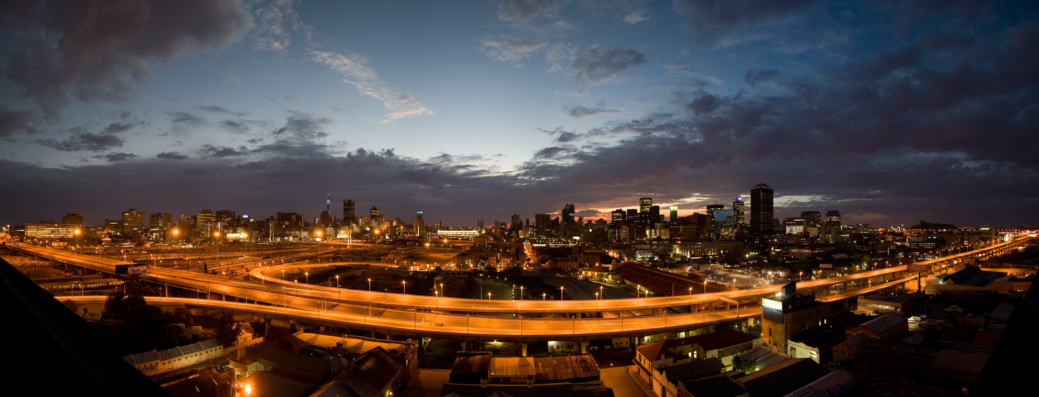
2019 Future of the City Centre Symposium
10 – 11 September
South Africa
Hosted by the UNISA Graduate School of Business Leadership

Slide 2
2019 Future of the City Centre Symposium
OPPORTUNITIES AND THREATS OF TRADING IN THE CITY OF TSHWANE (INCLUDING CHALLENGES AND SUCCESSES OF INFORMAL TRADING)
BENJAMIN MANASOE DIVISIONAL HEAD: ECONOMIC DEVELOPMENT

Slide 3
TABLE OF CONTENTS
Overview of the City of Tshwane
Development Approach
Strategic Policy Framework
Roles and Responsibilities of CoT in the informal trading sector
Types of Informal Traders
Types of License
License Application Requirements
Challenges of Informal Trading in CBD
City of Tshwane’s Programme to Support Informal Traders
10.1. Enterprise Development Pipeline
10.2. Development Programme
10.3. Business Support Centres /Hubs
Planned Infrastructure Projects 2019/20 FY
Conclusions

Slide 4
OVERVIEW OF THE CITY OF TSHWANE
IDP Strategic objective
“Facilitating Economic Growth and Job Creation”
Economic Development and Spatial Planning Department: Vision
“To lead the City of Tshwane integrated planning by maximizing spatial efficiencies for inclusive economic
growth”
Functional Areas (Economic Development Division)
SMME Support and Development
Cooperatives Support and Development
Sector Development and Support
Trade and Investment Facilitation and Business Retention & Expansion (BR&E)/ Aftercare
Business Regulation and Compliance
Pressure Points

Slide 5
DEVELOPMENTAL APPROACH
As a developmental local municipality, the City of Tshwane has acknowledged its obligation and responsibility to ensure that the City’s economic trajectory is firmly poised to effectively redress the primary challenges of underdevelopment, poverty and unemployment that continues to ravage our communities.
As a result, we seek to ensure that the City passes the litmus test by ensuring that its economic empowerment and emancipation strategies are symbiotic in order to systematically uproot unemployment, underdevelopment and poverty from its very core.
We believe that, the more people we lift from the trappings of absolute poverty, the faster we would be able to grow the economy.

Slide 6
STRATEGIC POLICY FRAMEWORK
National Development Plan - aims to eliminate poverty and reduce inequality by 2030.
New Growth Path: The new growth path is aimed creating 5 million jobs over 10 years to address unemployment, inequality and poverty by unlocking employment opportunities in South Africa's private sector by forming partnerships between key social players, business and government to address structural challenges in the economy.
IPAP: IPAP is a policy and action plan designed to help build South Africa’s industrial base in critical sectors of production and value-added manufacturing by focusing on labour-intensive industries.
Business Act of 71 of 1991 – Provides for licensing & carrying on of business and shop hours, to make certain provision regarding licensing and carrying on of business
Cooperatives amendment bill of Act 2005 – provides for the formation and registration of co-operatives
Small business Act of 2003) – regulates the small business environment in South Africa
GEGDS: GEGDS explains the strategic interventions by which Gauteng will work to make this innovating, green and inclusive economy a reality under 5 pillars are designed to ensure convergence between the economic and social strategies of government, underpinned by environmental strategies to ensure sustainable resource usage.
Municipal Strategies: Tshwane Investment Strategy; Tshwane Business Retention, Expansion and Attraction strategy, Tshwane Regional Industrial Strategy, Tshwane Small, Medium & Micro Enterprises strategy and Tshwane Cooperatives Development strategy, Street Trading By-Laws

Slide 7
BACKGROUND AND INTRODUCTION
“Informal trading" means the selling of any goods or the supply or offer to supply any service for reward as an informal trader in a public road or public space, but does not include the sale of newspapers only;
Informal trading provides livelihoods, employment and income for about 2.5 million workers and business owners.
One in every six South Africans who work, work in the informal sector It creates a livelihood opportunities , contribute to alleviating poverty and serves as a buffer between employment and unemployment
Informal trade enterprises contribute 8 to 10 % to GDP

Slide 8
ROLES AND RESPONSIBILITIES OF THE CITY OF TSHWANE IN THE INFORMAL TRADING SECTOR
Develop the informal trading policies, by-laws and implementation strategies
To increase contribution of the sector to the economy of Tshwane
Provision of conducive infrastructure for informal traders
Regulating informal traders through licensing
Establish the informal trading management body
Improve database management for informal traders
Train and reskill informal traders
Promote formal and informal business compliance
Provide defined areas for trading for informal traders

Slide 9
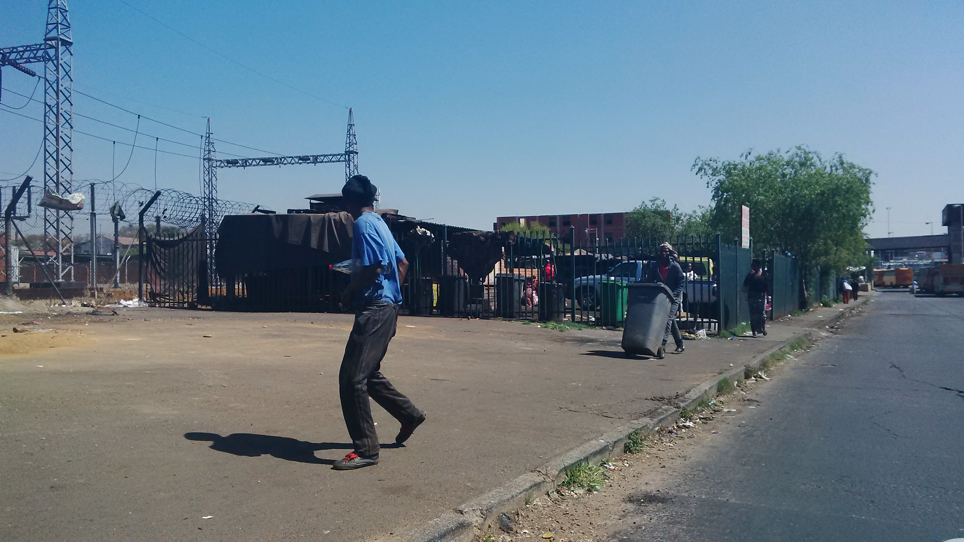
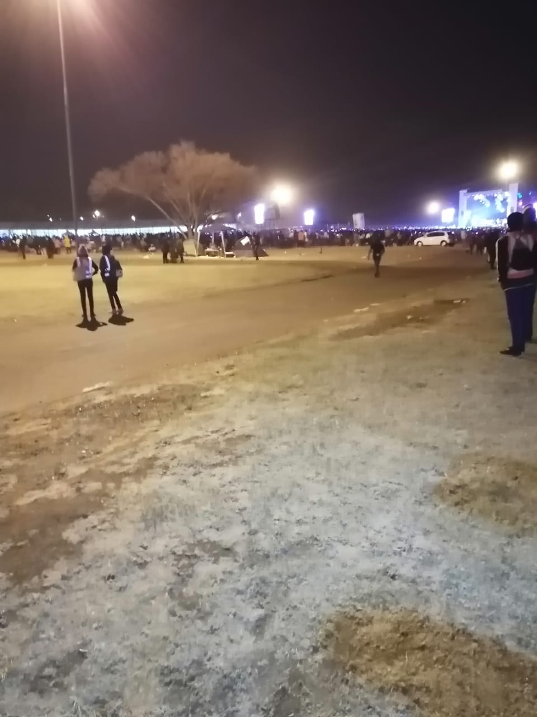
TYPES OF INFORMAL TRADERS
Open stalls
Built stalls /kiosk
Traffic lights/intersection
Events

Slide 10
TYPES OF LICENSE
Event License and Hawkers
Major events : soccer matches mainly at the stadium
Stand permit
Only on the restricted trading area or declared area
Trade License
Formal businesses

Slide 11
LICENSE APPLICATION REQUIREMENTS
Hawkers /permit and Event Licensees
Trade License
Identity document
Proof of residence
Attendance of compulsory workshop
Application form and payment
Zoning certificates
Id
CIPC and Tax certificates
Proof of residence
Menu in case of restaurant

Slide 12
CHALLENGES OF INFORMAL TRADING IN THE CBD
Lack of proper trading facilities (stalls etc)
Lack of storage facilities
Lack of access to finance
Limited business/entrepreneurial skills
High rate of crime
High health risk
Intimidation and harassment by law-enforcement agencies
Lack of access to basic amenities (water, sanitation, ablution facilities)
Harsh environmental conditions
Manual licensing system
Competition
Overcrowding
Illegal trading
Unregistered businesses
Poor stakeholder management
Culture of entitlement

Slide 14
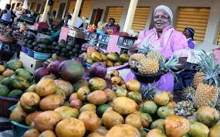

Slide 16
CITY OF TSHWANE’S PROGRAMME TO SUPPORT INFORMAL TRADERS
Street trading by-law review
Infrastructure support through trading stalls and storage facilities
Stakeholder management
Informal trading-by law workshops and roadshows
Automation of the licensing systems
Regular by-law awareness campaigns and enforcements
Entrepreneurship development programme

Slide 17
ENTERPRISE DEVELOPMENT PIPELINE
Awareness
Education & Information
Training and Capacity Building
Business Support Services & Mentorship
Business Linkages & Procurement
Business Infrastructure
Incubation
Business Finance
Baseline
Monitoring and Evaluation

Slide 18
ENTERPRISE DEVELOPMENT PROGRAMME INTERVENTIONS (5)
Mentorship
Linkages
Access to Finance
Business Support Services
Financial and Economic Literacy Programme
Exporters Training Programme
Start-up Enterprise Development Programme
Basic Entrepreneurship Programme
Technical Skills Training Programme
Advance Entrepreneurial Skills
Business Incubation

Slide 19
TSHWANE ENTERPRISE SMALL BUSINESS DEVELOPMENT PROGRAMME
Business Start-Up Training
5-days training and 11 weeks mentorship programme
Basic Entrepreneurship Training
5-days training and 11 weeks mentorship programme
Advanced Entrepreneurial Training
5-days training and 11 weeks mentorship programme
Basic Cooperatives Development Training
8-days training and 11 weeks mentorship programme
Advance Cooperatives Development Training
8-days training and 11 weeks mentorship programme.

Slide 20
BUSINESS SUPPORT CENTRES/ HUBS
Region 1: Mabopane Business Support Centre
Region 2: Hammanskraal Business Support Centre
Region 3: Atteridgeville Business Support Centre
Region 4 : Olievenhoutbosch Business Support Centre
Region 6: Mamelodi Business Support Centre
Region 7: Bronkhorstspruit Business Support Centre

Slide 21
BUSINESS SUPPORT CENTRES/ HUBS SERVICES
Business Advisory Services | Export Awareness Programme
Briefing sessions for new (potential) entrepreneurs Pre-consultation sessions for current business owners Consultation sessions with current business owners | Training Export marketing plan/strategy Trade exhibitions
Business Planning Support Services | Quality Assurance Services
Business Registration guidance Business plan training Business start-up training Development of business plans Marketing plan/strategy/research Viability/feasibility | Quality Management System implementation Quality Management System Certification Product certification and testing

Slide 22
BUSINESS SUPPORT CENTRES/ HUBS SERVICES (2)
Infrastructure Support | Enterprise Development Capacity Building Services
Meetings rooms/ Boardrooms Computers Printers | Business Systems Development Growth Strategies Financial Management Implementation Intellectual property registration Joint ventures / ownership agreement Skills Development planning Mentorship HR Policies and Planning Turn-around strategies Promotional material E-marketing support Signage Process development Product development Information Communication Technology

Slide 24
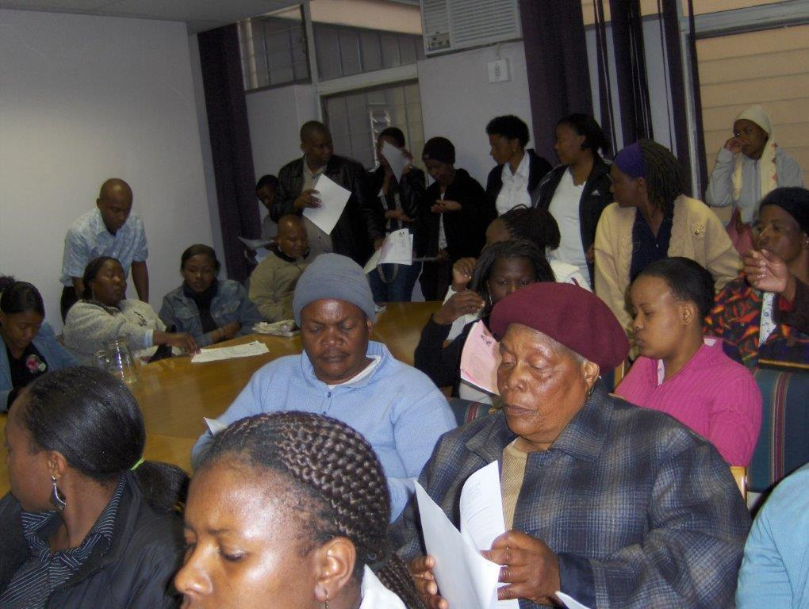

Slide 26
PLANNED INFRASTUCTURE PROJECTS - 2019/20 FY
PROJECT NAME | BUDGET
Church Street Stalls | R5m
Marabastad Stalls | R5m
Barolak trading hub | R7m
Cullinan Stalls | R2m
Bronkhorstspruit Stalls | R2m
Total Budget | R21m

Slide 27
CONCLUSION
As a department, we will continue with our mission to create an enabling environment for business development and support by providing leadership, facilitating strategic partnerships and ensuring small businesses’ engagement in the economic development activities of Tshwane in order to achieve competiveness, job creation, growth and poverty eradication
Skills development and entrepreneurship is the future of our city and the country as a whole, hence our investment should be directed to this area:
Let’s Leave behind mindset of Entitlement – ‘Give us work’
But encourage a culture of Entrepreneurship
Success isn’t given to the deserving……. It’s taken by the ambitious!!!!

Slide 28
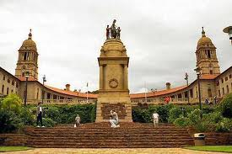
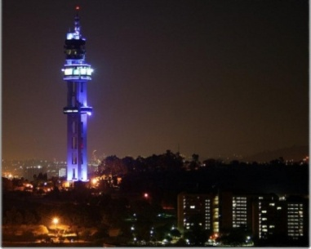
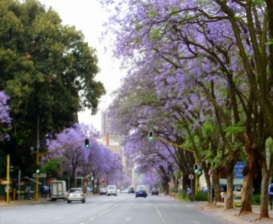
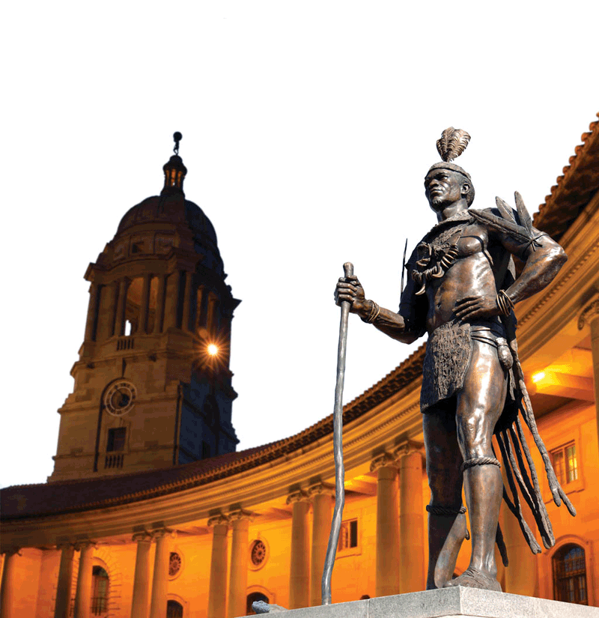
I Thank You

